Slide 1
SOFTWARE SUPPLY CHAIN SECURITY: ATTACKS, DEFENSES, AND THE ADOPTION OF SIGNATURES
1LT Taylor R. Schorlemmer
Notes:
Hello

Slide 2




Acknowledgements
Notes:
Thanks to:
Purdue Military Research Institute
Google
Cisco
National Science Foundation
Committee – Feedback, assistance, and knowledge
Esp. J. C. Davis – Chair/Advisor

Slide 3
Agenda
Introduction
Background: SSC
SSC Attacks
Properties for Secure SSCs
Background: Software Signing
Signing Adoption Theory
Research Questions
Methodology
Results
Future Work
Overview and Questions
Work 1: SSC SoK
Work 2: Signature Adoption
Notes:
First broadly introduce my research
Next discuss my first work SoK on SSC
Background
Attacks
Properties
Then next work on Signature Adoption
Background
Adoption Theory
RQs for signing adoption
Methods for answering
Our results
Future Work
An overview + questions

Slide 4
Introduction

Slide 5
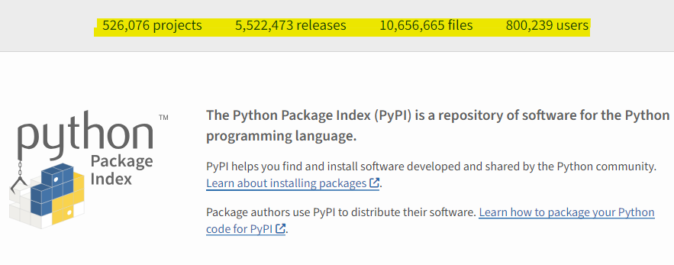
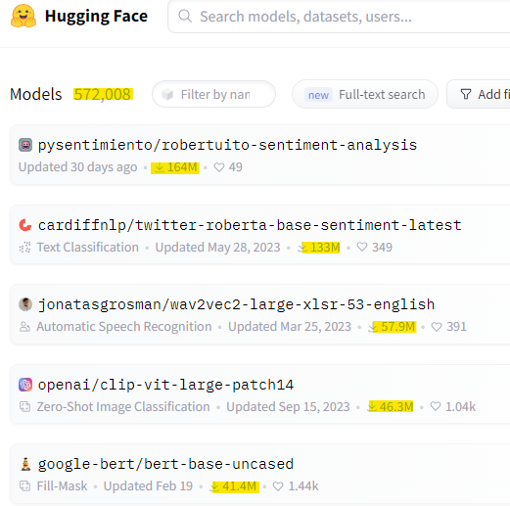
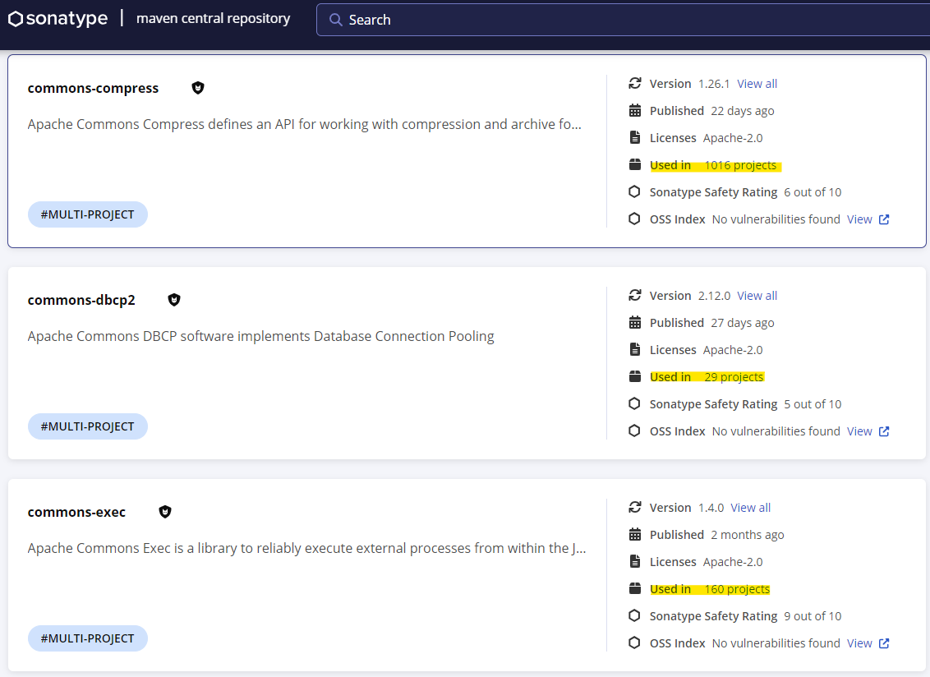
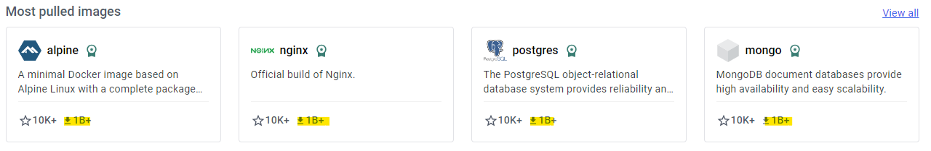
Motivation
Introduction
Modern software relies on 3rd party dependencies
Notes:
Modern SW relies on 3rd party
Example SW package registries
Hugging Face contains over ½ mil PTMs
10s to 100s of mil downloads on top models
PyPI over ½ mil Python packages
Includes over 10 mil SW artifacts
Maven about ½ mil java packages
Some w/ lots of dependencies
Docker over 1 mil Images
Some of most downloaded over 1 bil

Slide 6
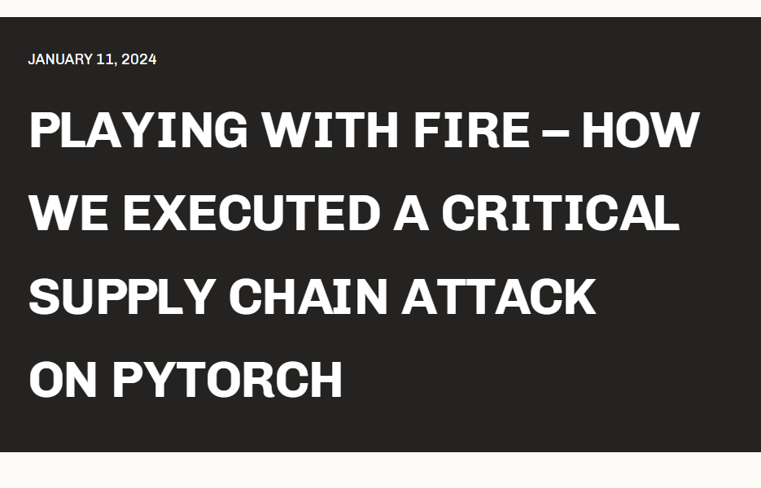
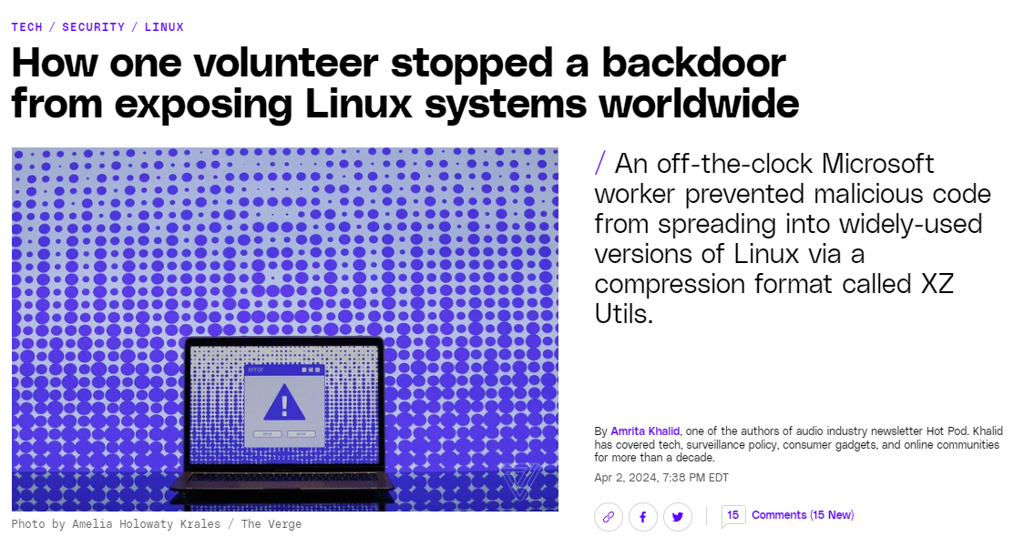
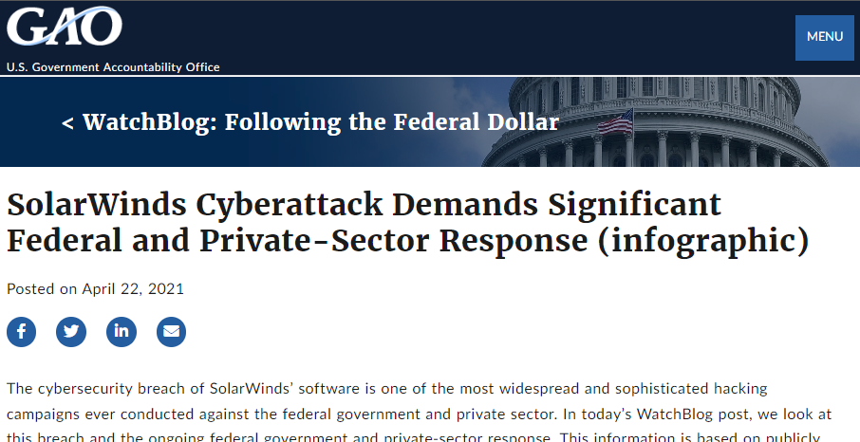
Motivation
Introduction
Modern software relies on 3rd party dependencies
This creates a software supply chain – attack vector
Notes:
This creates a supply chain of software dependencies
This software supply chain can be attacked
In 2019 malicious actors (likely a Russian APT)
gained access to SolarWind’s build infrastructure and inserted malicious code in 2020
This affected over 18k customers including govt. (DHS, State, commerce, treasury etc.) and industry (Microsoft, Intel, Cisco)
In January, security researchers executed an SSC “attack” on PyTorch
A common ML library
They gained access to CI/CD pipeline which allowed them to execute code & upload malicious PyTorch releases
In the past few days, a developing SSC attack on linux was discovered.
In the XZ Utils library
User used social engineering to gain access to repository
Created malicious changes
Only caught by a SWE doing benchmarking

Slide 7
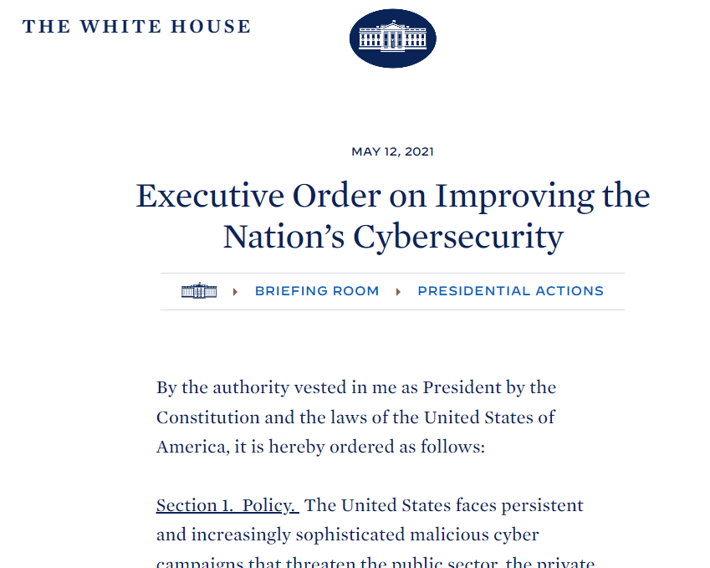
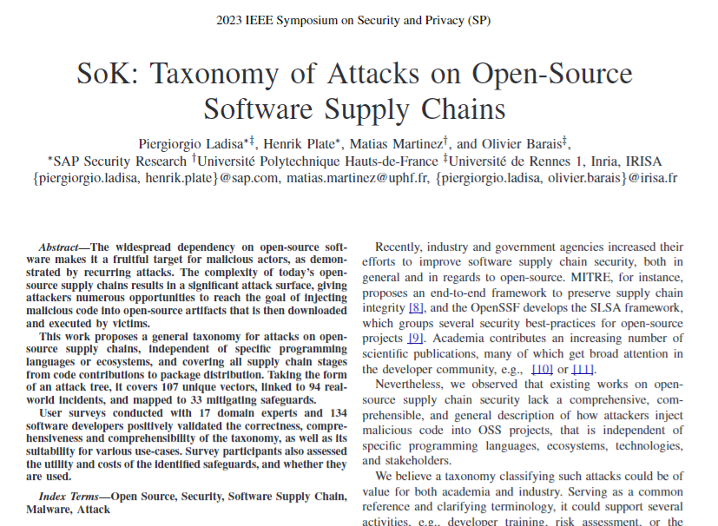
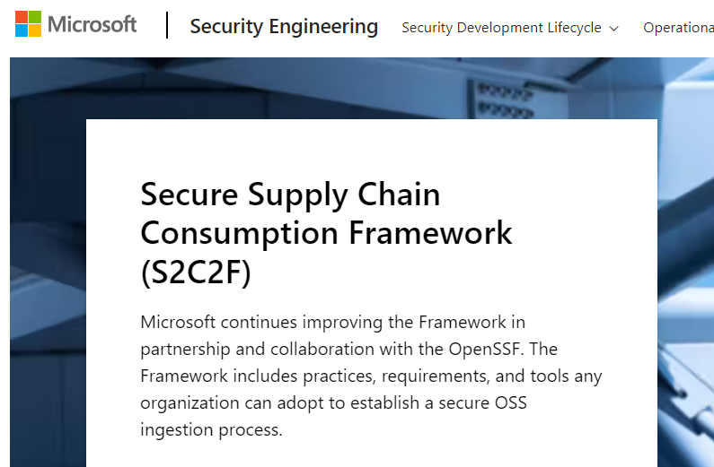
Motivation
Introduction
Modern software relies on 3rd party dependencies
This creates a software supply chain (SSC) – attack vector
Government, industry, and academia push for secure SSC
Notes:
Governments, industry, and academia have pushed for ways to secure SSC
For Example
E.O. 14028 in 2021 directed govt. orgs such as NIST, NSA, CISA to:
create SSC standards
Assess critical SW
Microsoft w/ Open Software Security Foundation create S2C2F:
Requirements + tools for orgs
Focus on how to securely consume + manage open source dependencies
Paper by Ladisa et. al.
Taxonomize attacks
Validate with surveys of SWE

Slide 8
Thesis
Introduction
Since modern software relies increasingly on third party dependencies, software supply chain attacks are a growing, and challenging, threat. As a result, techniques like software signing must be effectively implemented to provide defensive benefits.
Notes:
This brings me to my thesis
read

Slide 9
Focus Papers
Introduction
Signing in Four Public Software Package Registries: Quantity, Quality, and Influencing Factors
Schorlemmer, Kalu, Chigges, Ko, Ishgair, Bagchi, Torres-Arias, and Davis.
Proceedings of the 45th IEEE Symposium on Security and Privacy (S&P’24) 2024.
SoK: Analysis of Software Supply Chain Security by Establishing Secure Design Properties
Okafor*, Schorlemmer*, Torres-Arias, and Davis.
Proceedings of the 1st ACM Workshop on Software Supply Chain Offensive Research and Ecosystem Defenses (SCORED) 2022.
An Empirical Study of Artifacts and Security Practices in the Pre-trained Model Supply Chain
Jiang, Synovic, Sethi, Indarapu, Hyatt, Schorlemmer, Thiruvathukal, and Davis.
Proceedings of the 1st ACM Workshop on Software Supply Chain Offensive Research and Ecosystem Defenses (SCORED) 2022.
An Empirical Study on Using large Language Models to Analyze Software Supply chain Security Failures
Singla, Anandayuvaraj, Kalu, Schorlemmer, and Davis.
Proceedings of the 2nd ACM Workshop on Software Supply Chain Offensive Research and Ecosystem Defenses (SCORED) 2023.
Reusing Deep Learning Models: Challenges and Directions in Software Engineering
Davis, Jajal, Jiang, Schorlemmer, Synovic, and Thiruvathukal.
Challenges and Directions in Software Engineering. IEEE JVA Symposium on Modern Computing at IEEE Services 2023.
PTMTorrent: A Dataset for Mining Open-source Pre-trained Model Packages
Jiang, Synovic, Jajal, Schorlemmer, Tewari, Pareek, Thiruvathukal, and Davis.
Proceedings of the 20th Annual Conference on Mining Software Repositories — Data and Tool Showcase Track (MSR- Data’23) 2023.
An Empirical Study of Pre-Trained Model Reuse in the Hugging Face Deep Learning Model Registry
Jiang, Synovic, Hyatt, Schorlemmer, Sethi, Lu, Thiruvathukal, and Davis.
Proceedings of the ACM/IEEE 45th International Conference on Software Engineering (ICSE) 2023.
Reflecting on the use of the Policy-Process-Product Theory in Empirical Software Engineering
Kalu, Schorlemmer, Chen, Robinson, Kocinare, and Davis.
Proceedings of the 31st ACM Joint Meeting on European Software Engineering Conference and Symposium on the Foundations of Software Engineering: Ideas, Visions, and Reflections track (ESEC/FSE-IVR) 2023.
SSC
Security
PTM
Reuse
SE
Notes:
While at purdue, I’ve had the pleasure of working on several projects
Significant contributions/ authorship on 8 published papers
1 First author; 1 Co-first author
3 categories:
SSC Security
PTM Reuse
SE
Two of these address my thesis
SoK
Background of SSC
Attack Pattern
Properties of Secure SSC
Signing
Deep dive into signing
Core of my thesis

Slide 10
Contributions
Introduction
An attack pattern for software supply chain attacks
Properties for a secure software supply chain
Up-to-date measurements of software signing practices in four major package registries
Quantity – how many?
Quality – how good?
Quasi-experiment to estimate effect of factors on signing practices
Policies have a notable effect on quantity
Tooling has a notable effect on quality
Notes:
My contributions are as follows:
Attack pattern
GAP: Ambiguity on what constitutes a “SSC attack” in literature
4 stage pattern
Properties for a secure SSC
GAP: lots of frameworks/techniques
Distilled down to 3 properties
Measurements for signing
A technique for SSC security
4 registries
GAP: These measurements haven’t been compiled before
Quantity
Quality
Quasi-experiment for factors
GAP: why don’t people use signatures?
Provide some explanation
Key findings
Policies – quantity
Tooling - quality

Slide 11
Background: SSC

Slide 12
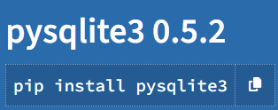
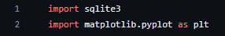
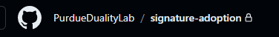
Software Supply Chain
Background: SSC
Upstream Software
Your
Software
Downstream
Software
Notes:
I’ve been talking a lot about SSCs
What do they look like?
First – Upstream software
Typically, something someone else made
Example: package on PyPI
Allows user to interact with SQLite3 DB
Pip install to include
Your software
Project you/your org creates
Example: code I wrote to collect data
Python import
Use to connect db
Downstream software
You may publish/someone could use your software
Example: someone may use my code/tools

Slide 13


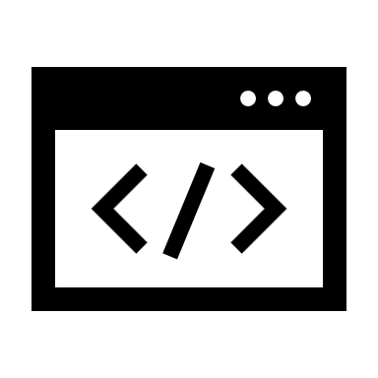
SSC Components
Background: SSC
Upstream Software
Your
Software
Downstream
Software
Actors
Artifacts
Operations
Notes:
What are SSCs made of?
In each link:
Actors - manipulate artifacts and operations within the supply chain to produce an output
Artifacts - include the product team’s code, development infrastructure, and software dependencies
Operations - include productive steps such as fetching dependencies or compiling software, protective steps such as linting or security scans, and publishing steps such as deployment or distribution

Slide 14
SSC Attacks

Slide 15
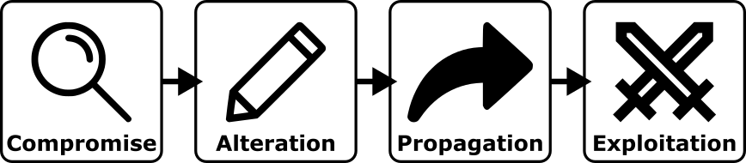
Attack Pattern
SSC Attacks
1. Compromise: First, an attacker finds and compromises an existing weakness within a supply chain.
Notes:
Attackers can leverage implicit trust in SSCs
“Software Supply Chain Attack”
Competing definitions for attack in literature
In SoK we condensed this down into 4 stage attack pattern
First stage is compromise
Attacker compromises an existing weakness in supply chain

Slide 16
Attack Pattern
SSC Attacks
1. Compromise: First, an attacker finds and compromises an existing weakness within a supply chain.
2. Alteration: Second, an attacker leverages the initial compromise to alter the software supply chain.
Notes:
Second stage is alteration
Initial compromise is leveraged to alter the SSC
Malicious changes

Slide 17
Attack Pattern
SSC Attacks
1. Compromise: First, an attacker finds and compromises an existing weakness within a supply chain.
2. Alteration: Second, an attacker leverages the initial compromise to alter the software supply chain.
3. Propagation: Third, the change introduced by the attacker propagates to downstream components and links.
Notes:
Third stage: propagation
SSC flows upstream -> downstream
Changes impact downstream components

Slide 18
Attack Pattern
SSC Attacks
1. Compromise: First, an attacker finds and compromises an existing weakness within a supply chain.
2. Alteration: Second, an attacker leverages the initial compromise to alter the software supply chain.
3. Propagation: Third, the change introduced by the attacker propagates to downstream components and links.
4. Exploitation: Finally, the attacker exploits the alterations in a downstream link.
Notes:
Fourth & final stage Exploitation:
Attacker exploits alterations in downstream link
“effects”
Stopping an attacker at any of these stages prevents the attack from happening.

Slide 19
Example SSC Attack | SolarWinds
SSC Attacks
Compromised build infrastructure
Altered code
Propagated change to customers
Exploited authentication
Notes:
The go-to example for SSC attacks is SolarWinds – I briefly discussed this earlier
Lets see how it fits
Compromise
Attackers gained access to solar winds build infrastructure
Alteration
Attackers modified Orion (server monitoring)
Propagation
The change was pushed as an update to their clients
Exploitation
Attackers used this to gain entry into client servers

Slide 20
Not a SSC Attack by Our Definition | Log4J
SSC Attacks
Compromised ?
Altered ?
Propagated to users
Exploited vulnerability
Vulnerabilities in dependencies != SSC Attack
Attackers must introduce upstream change
AND exploit it downstream
Notes:
By our definition, some attacks aren’t SSC attacks
Log4J is often referred to as a SSC attacks, but our definition disagrees.
Here’s why:
Log4J is a logging library
A vulnerability in the library allowed attackers to gain access to any system running it
Compromise
Attackers didn’t have an initial compromise
Alteration
Attackers didn’t change anything
Propagation
The vulnerability did make it to downstream components
Exploitation
Adversaries were able to take advantage of the vuln
Bottom line:
Just because you depend on something vulnerable, does not mean SSC attack
Attackers intro upstream change AND exploit that change downstream
Otherwise you can start classifying all sorts of things as SSC attacks

Slide 21
Properties for Secure SSCs

Slide 22
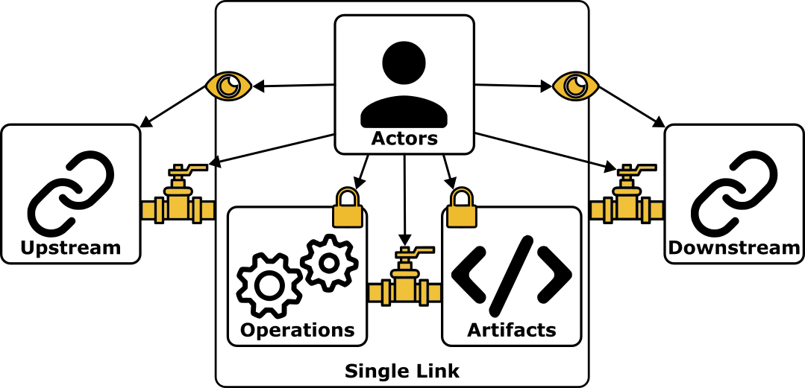
Properties for Security
Properties for Secure SSCs
Transparency: availability of knowledge to actors [NIST 2022, Ellison 2010, Ensor 2021, Ladisa 2022, Microsoft 2021]
Validity: integrity of operations/artifacts and authentication of actors [NIST 2022, Ellison 2010, Microsoft 2021, Torres-Arias 2019, Zahan 2022]
Separation: compartmentalization between supply chain components [Ladisa 2022, Microsoft 2021, Zahan 2022]
Notes:
SSC can be attacked, but how do we defend them?
This figure shows a SSC with components
Zoomed into single link
In SoK we compiled 3 properties from literature
Transparency
Validity
Seperation

Slide 23
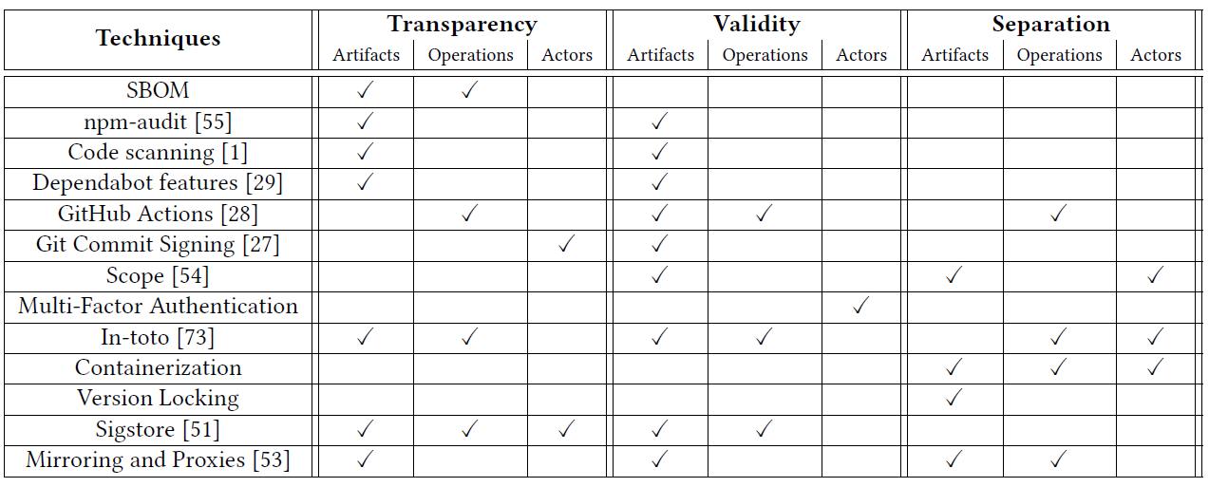
Defensive Techniques
Properties for Secure SSCs
Okafor et. al. SoK: Analysis of Software Supply Chain Security by Establishing Secure Design Properties. SCORED 2022.
Notes:
In SoK co-first author did a lot of work mapping these properties to current techniques
As you can see, software signing is one of these techniques.

Slide 24
Background: Software Signing
Notes:
This moves me into my next line of work on Software Signing

Slide 25
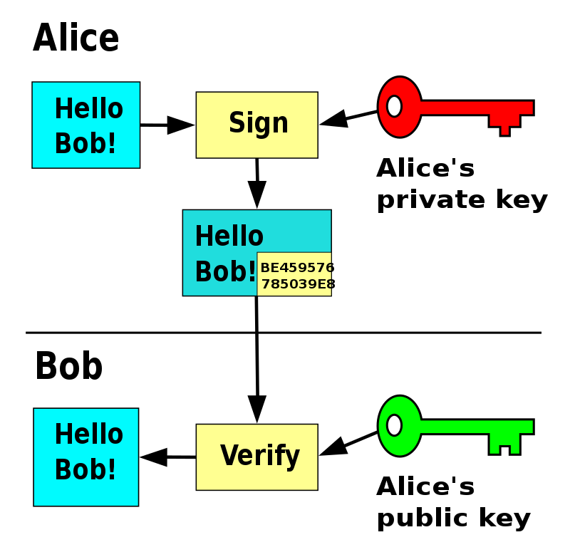
What is Signing?
Background: Software Signing
Cryptographic proof of ownership
Provides two guarantees
Signed artifact created by actor
Signed artifact has not changed
Does not guarantee good software
https://en.wikipedia.org/wiki/Digital_signature
Notes:
What is a signature?
Cryptographic proof of ownership
Talk diagram:
Alice has a message and a private key
Alice uses private key + message to create signature
Appends signature to message
Sends to bob
Bob gets message + signature
Bob uses alice’s public key to verify signature
Two guarantees:
Created by actor
Artifact hasn’t changed
Doesn’t mean good SW

Slide 26
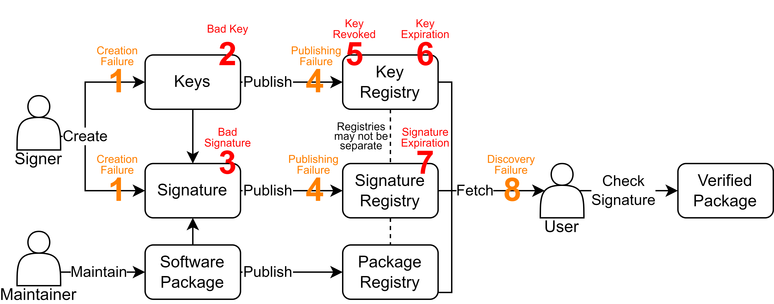
Process & Failures
Background: Software Signing
Notes:
I’ll walk through how this process works in practice and how it can go wrong
First, maintainer creates/maintains SW package
Next signer (could also be maintainer) creates keys + signature
They could fail to do so – creating a signature isn’t always required
Keys might be bad (wrong key, corrupted, etc)
Signature might be bad (incorrect or unverifiable, signed wrong artifact, unsupported alg, incompatible format)
Next, published
They may fail to publish the key/signature
Sometimes no requirement
Things sit on registries (may be the same)
Key may be revoked (theft/key rotation)
Key may expire (associated signatures no longer valid)
Signature may expire
User fetches things
May fail to discover
User validates signature
Note: all orange failure modes are indistinguishable from the user
Cant tell if discover failure or it doesn’t exist

Slide 27
Signing Adoption Theory
Notes:
Using existing literature, we devised a theory to explain a maintainers decision to sign

Slide 28
Influence of Incentives
Signing Adoption Theory
Notes:
Based on behavioral economics
Dev theory of influence of incentives on signature adoption
Incentives influence maintainers

Slide 29
Incentives Considered
Signing Adoption Theory
Registry Policies
Policies that explicitly encourage or discourage software signing
Dedicated Tooling
Tools which simplify the signing workflow
Signing Events
Cybersecurity events such as cyberattacks or the publication of government/industry standards
High Startup Cost
The first signature might be the hardest
Notes:
We consider these four
Others likely exist, but we did not explore them

Slide 30
Research Questions

Slide 31
Theme 1: Measuring Signing in Four Package Registries
Research Questions
RQ1: What is the current quantity and quality of signing in public registries?
RQ2: How do signing practices change over time?

Slide 32
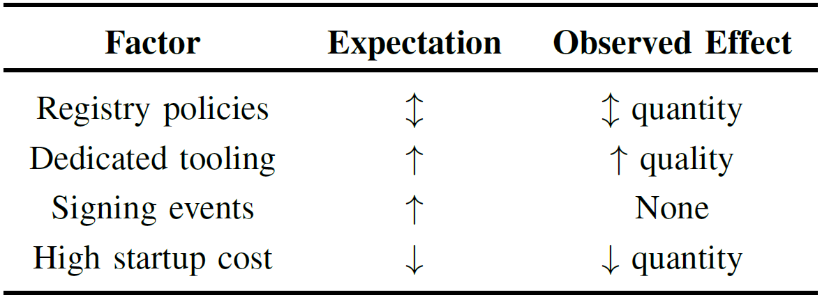
Theme 2: Signing Incentives
Research Questions
RQ3: How do signing incentives influence signature adoption?
H1: Registry policies that explicitly encourage or discourage software signing will have the corresponding direct effect on signing quantity.
H2: Dedicated tooling to simplify signing will increase signing adoption (quantity and quality).
H3: Cybersecurity events such as cyberattacks or the publication of relevant government or industry standards will increase signing adoption (quantity and quality).
H4: The first signature is the hardest, i.e., after a package is configured for signing adoption, it will continue to be signed.

Slide 33
Methodology

Slide 34
Methods Overview
Methodology
Select Registries
Collect Packages
Filter Packages
Measure Signature Adoption
Evaluate Adoption Factors

Slide 35
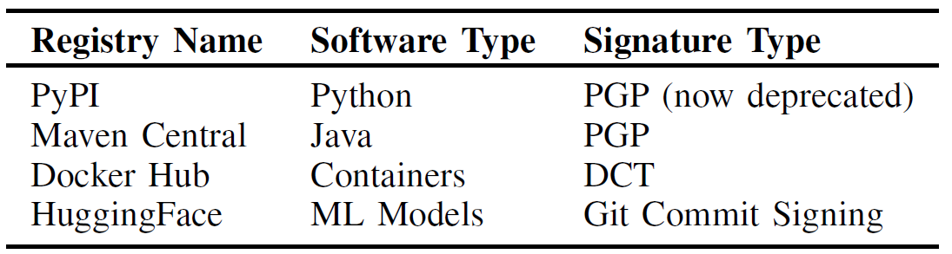
1: Selected Registries
Methodology
Notes:
Select registries with
variations in incentive
Experienced change
Maintainer-signed signatures
Popular

Slide 36
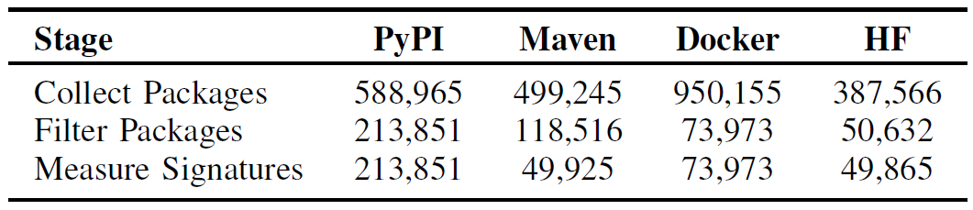
2/3: Package Collection and Filtration
Methodology
Notes:
Filter: 5 versions

Slide 37
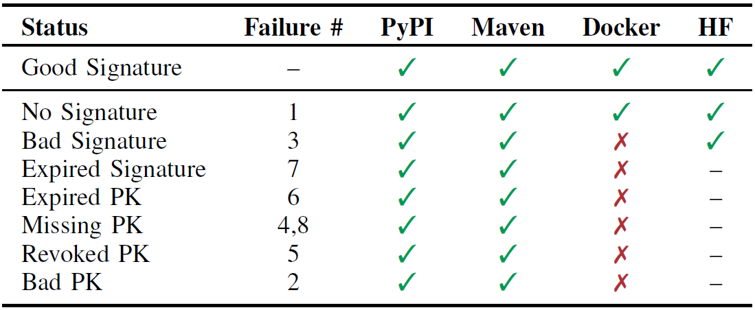
4: Measure Adoption
Methodology
Notes:
Next, we measure adoption on selected packages from registries
We can only measure certain failure types from each registry
PyPI + Maven – measure all failure modes
Docker – Uses DCT, which doesn’t fail like PGP (Only good or not there)
HF –
should be able to measure everything
Unfortunately, the way they set up system doesn’t allow us to
Notified, considered adding this

Slide 38
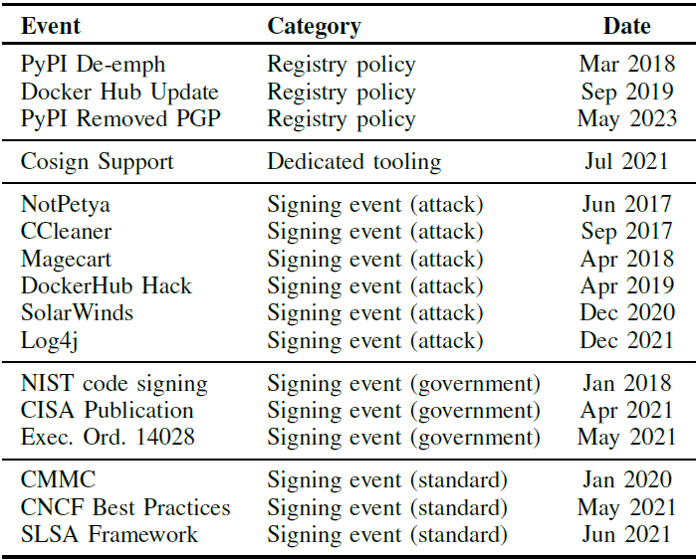
5: Evaluate Adoption
Methodology
RQ1/2 – Simple measurements and trends
RQ3 – Quasi experiment to evaluate hypotheses
Assume structural similarity between registries
Evaluate a list of possible factors

Slide 39
Results

Slide 40
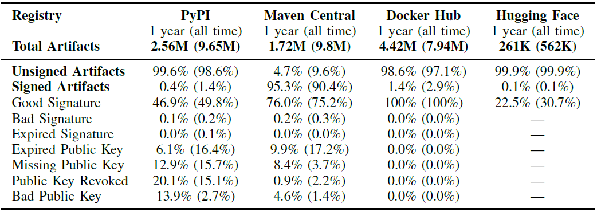
RQ1: Current Quantity and Quality of Signatures
Results
Notes:
Between OCT 2022 and SEP 2023 all registries (except Maven Central) had less than 2% of artifacts signed
Maven had 95.3% of artifacts signed in the same time period (mandated signing)
Signing failures are common
24.0% of Maven Central signatures invalid
53.1% of PyPI signatures invalid
77.5% of Hugging Face signatures invalid
None of Docker Hub signatures invalid (dedicated tooling)

Slide 41
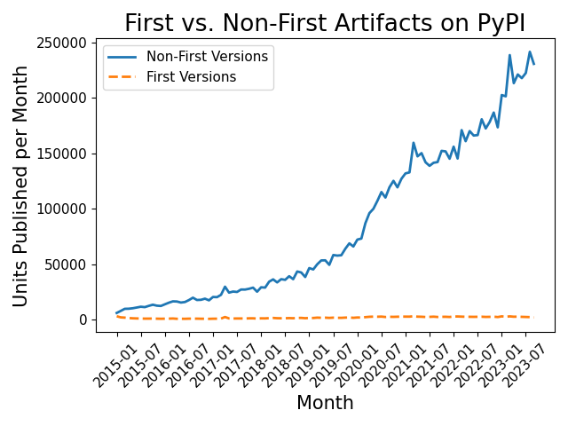
RQ2: Change in Signing Over Time
Results
Notes:
First, to see if any of our later results are biased by new packages
We plot first vs non-first artifacts
Large gap between these lines shows that “new packages” don’t account for the lack of signing or failures
Looks similar on other registries

Slide 42
RQ2: Change in Signing Over Time
Results
Notes:
Maven higher over entire period
Docker slight bump
Quality is excellent on docker,
Not so great on others
HF spikey

Slide 43
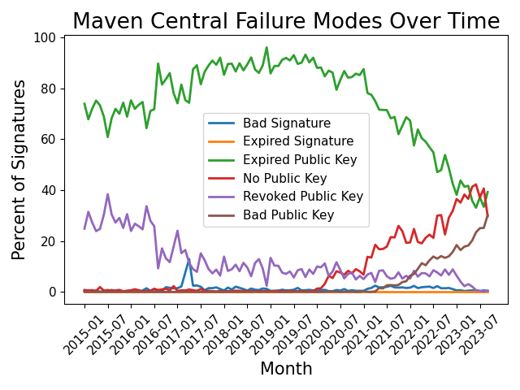
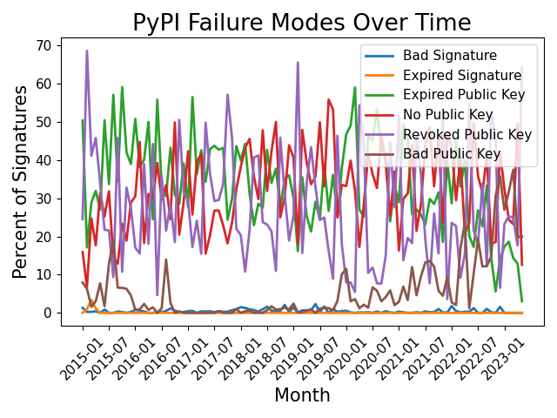
RQ2: Change in Signing Over Time
Results
Notes:
Since we can measure all failure modes on Maven & PyPI we can plot them over time

Slide 44
RQ3: Influence of Incentive
Results
H1: Registry Policies
H2: Dedicated Tooling
H3: Cybersecurity Events
H4: Startup Cost
Notes:
Recall our 4 hypotheses & the events we used to test them.

Slide 45
RQ3: Influence of Incentive (H1 - Registry Policies)
Results
Notes:
PyPI deemp
Docker Update
Maven way higher

Slide 46
RQ3: Influence of Incentive (H2 – Dedicated Tooling)
Results
Notes:
Docker

Slide 47
RQ3: Influence of Incentive (H3 – Signing Events)
Results
Notes:
Docker Hack Apr 2019
Solar Winds Dec 2020

Slide 48
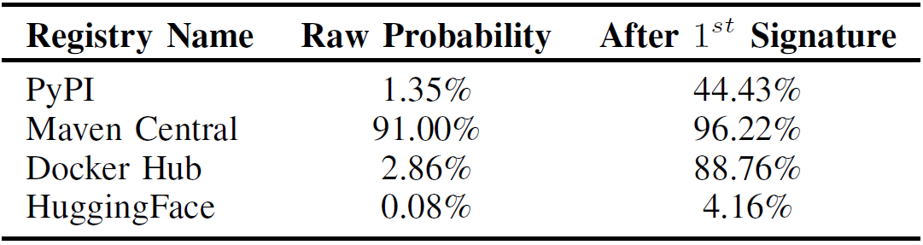
RQ3: Influence of Incentive (H4 – Startup Cost)
Results

Slide 49
Future Work

Slide 50
Software Supply Chain Security
Future Work
Further investigations of signing
Do we even need signatures?
Additional techniques – doing more with less

Slide 51
Secure Machine Learning
Future Work
Differences between traditional and ML supply chains
What tools still work?
Do we need new ones?
How to safely integrate ML into SE projects?

Slide 52
Overview and Questions

Slide 53
Overview
Introduction
Background: SSC
SSC Attacks
Properties for Secure SSCs
Background: Software Signing
Signing Adoption Theory
Research Questions
Methodology
Results
Future Work
Thank You!
Questions?
1LT Taylor R. Schorlemmer
tschorle@purdue.edu
https://taylor.schorlemmer.us/

Slide 54
Thank You
1LT Taylor R. Schorlemmer
tschorle@purdue.edu
https://taylor.schorlemmer.us/

